Slide 1
Conjunctivitis
Pediatric Continuity Clinic Curriculum
Created by: Priya Tanna

Slide 2
Objectives
Differentiate between bacterial, viral, and allergic conjunctivitis
Discuss the most common etiologic agents of conjunctivitis in various age groups
Determine when ophthalmology referral is indicated for a red eye

Slide 3
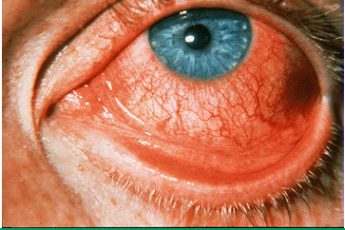
Case #1
A 5-year-old boy presents with a 3-day history of watery discharge from his right eye. The eye is red. Similar findings have occurred in his left eye as of that morning. He is not particularly photophobic and his eyes are not itchy. He is healthy, but just got over an upper respiratory tract infection approximately 3 days ago. On examination, the patient is not in acute distress. He is afebrile, has normal visual acuity, and demonstrates moderate bilateral conjunctival injection and tender preauricular nodes.
Discussion Questions:
What is the diagnosis, what clinical manifestations point you toward this diagnosis, and what is the treatment?
Differentiate between bacterial, viral, and allergic conjunctivitis in terms of clinical presentation and treatment.

Slide 4
Case #1
1. What is the diagnosis?
Viral conjunctivitis
2. What clinical manifestations point you toward this diagnosis?
Recent upper respiratory tract infection
Watery discharge
Tender preauricular nodes
3. What is the treatment?
Supportive measures (cold compresses, artificial tears, etc.)
Notes:
Most viral conjunctivitis is caused by adenovirus
Several forms of adenoviral infection occur (follicular conjunctivitis, pharyngoconjunctival fever, epidemic keratoconjunctivitis)
All forms of adenoviral conjunctivitis are extremely contagious
Transmission of infection is usually through direct contact with infected persons or contact with contaminated instruments
Affected child should be kept home for approximately 1 week after the onset of symptoms

Slide 5
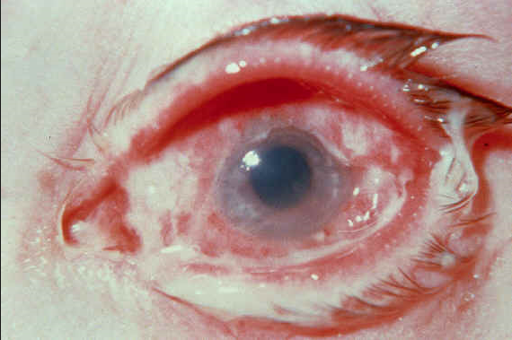
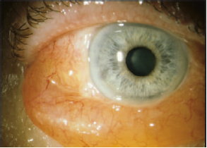
Differentiate between bacterial, viral, and allergic conjunctivitis
Bacterial conjunctivitis
Viral conjunctivitis
Allergic conjunctivitis
Notes:
Refer to next slide for characteristics of bacterial, viral, and allergic conjunctivitis

Slide 6
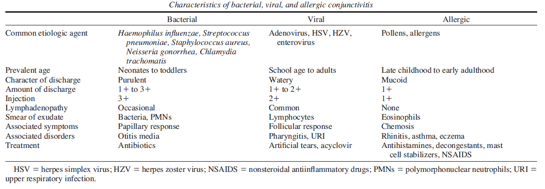
Characteristics of bacterial, viral, and allergic conjunctivitis
Notes:
Bacterial conjunctivitis: - neonates are more likely to have bacterial etiology than older children
- in acute bacterial conjunctivitis, H. influenzae is most commonly isolated organism (followed by S. pneumoniae and Moraxella catarrhalis)
- itching, burning, mucopurulent or purulent discharge, eyelid edema, or conjunctival erythema
- associated otitis media is highly suggestive of a bacterial etiology
- treatment – topical antibiotics (trimethoprim-polymyxin / Polytrim)
- low contagiousness (these children usually do not need to be isolated)
Viral Conjunctivitis: - refer to slide 4
Allergic Conjunctivitis: - considered chronic condition with frequent recurrences
- patients usually have history of other atopic disease (eczema, asthma, rhinitis)
- an immunoglobulin E-mediated hypersensitivity reaction to an allergen produces the clinical manifestations
- bilateral involvement, itching, tearing, mucoid discharge, redness, mild eyelid edema, chemosis
- treatment – allergen avoidance, cold compresses, antihistamines, topical NSAIDs, H1 receptor antagonists, mast cell stabilizers (olopatadine)

Slide 7
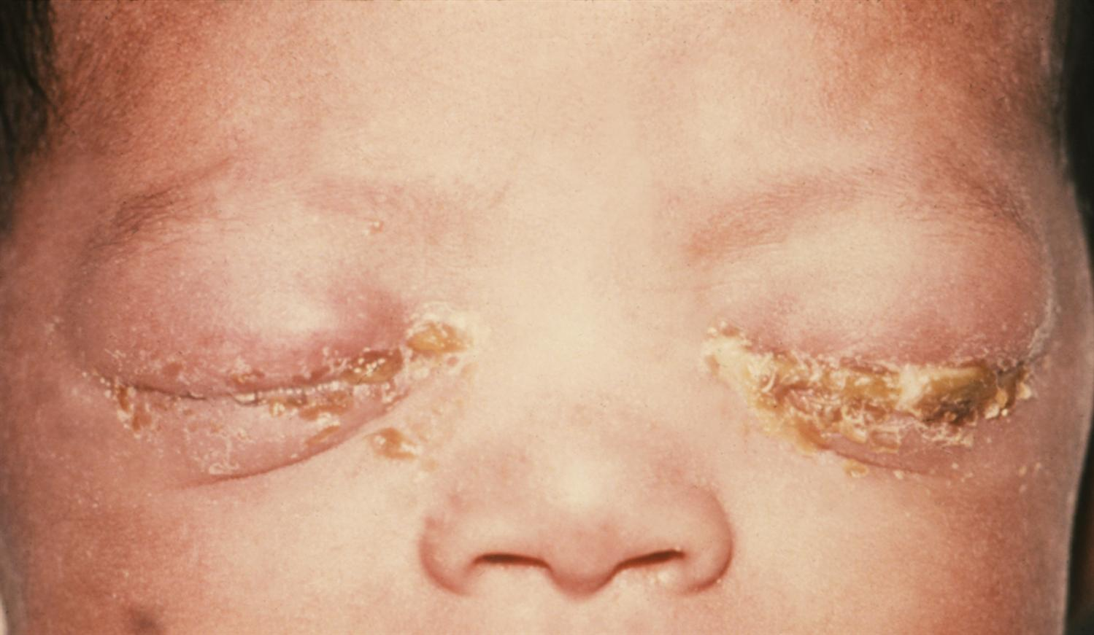
Case #2
A 3-day-old male develops bilateral purulent eye discharge. He also exhibits a runny nose as well as eyelid edema and redness.
Discussion Questions:
What is the diagnosis?
What could have been given as standard prophylaxis to prevent the development of this infant's condition?
What is the treatment of this condition?
Name 3 common types of neonatal conjunctivitis and the timing of their presentation.

Slide 8
Case #2
1. What is the diagnosis?
Gonococcal ophthalmia neonatorum
2. What could have been given as standard prophylaxis to prevent the development of this infant's condition?
Topical 0.5% erythromycin
3. What is the treatment of this condition?
Ceftriaxone IM or IV (Can also use Cefotaxime if hyperbilirubinemia present)
4. Name 3 common types of neonatal conjunctivitis and the timing of their presentation.
Chemical - within first 24 hours of life
Gonococcal - 3-5 days after birth
Chlamydial - 5-10 days after birth (but can develop several weeks later)
Notes:
Opthalmia Neonatorum: Conjunctivitis in the first month of life
1. Chemical conjunctivitis – occurs within the first 24 hours of life
- most likely an irritant reaction to ocular prophylaxis (most often seen with silver nitrate, and less often with erythromycin or tetracycline prophylaxis)
- mild, purulent conjunctivitis within the first 24 hours and resolution within 48 hours
- treatment: none (self-limited condition that requires just observation)
Gonococcal Conjunctivitis – occurs within the first 3-5 days of life
- etiologic agent is N. gonorrhea
- sudden, severe, grossly purulent conjunctivitis
- if not recognized, can rapidly progress within 24 hours to ulceration and perforation of the globe
- culture and gram stain of conjunctival scrapings should be obtained (gram negative diplococci would be seen)
- treatment: hospitalization, adequate eye irrigation, administration of IV/IM ceftriaxone (as single dose)
- mother and her sexual contacts should be treated for gonorrhea
Chlamydial Conjunctivitis – occurs within few days to several weeks after birth
- etiologic agent is C. trachomatis
- neonatal ocular prophylaxis with silver nitrate, erythromycin, or tetracycline does not prevent chlamydia conjunctivitis
- presentation can vary (from mild to moderate conjunctival erythema, and from scant/mucoid discharge to copious/purulent discharge)
- treatment: oral erythromcyin for 10-14 days
- mother and her sexual contacts should be treated for chlamydia

Slide 9
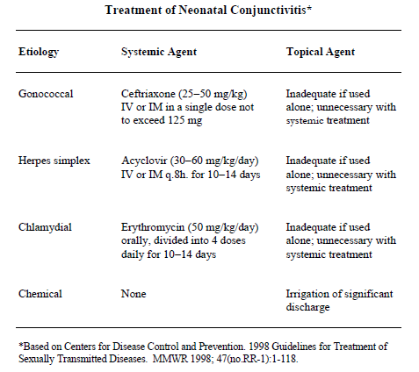
Treatment of Neonatal Conjunctivitis

Slide 10
Diagnosis of Conjunctivitis by Age
Neonate
< 24 hours old
Chemical
Gram stain and culture
Older infant, toddler
School-aged child, adolescent
Otitis media present
Otitis media absent
Observation
N. gonorrhea
IV/IM ceftriaxone, eye irrigation
H. Influenzae nontypeable
Oral antibiotics
Viral
Allergic
Supportive care
Antihistamines, NSAIDs, H1-receptor antagonists, mast cell stabilizers
Oral erythromycin
C. trachomatis
Topical antibiotics
S. pneumonia, M. catarrhalis, H. influenzae
Child with conjunctivitis

Slide 11
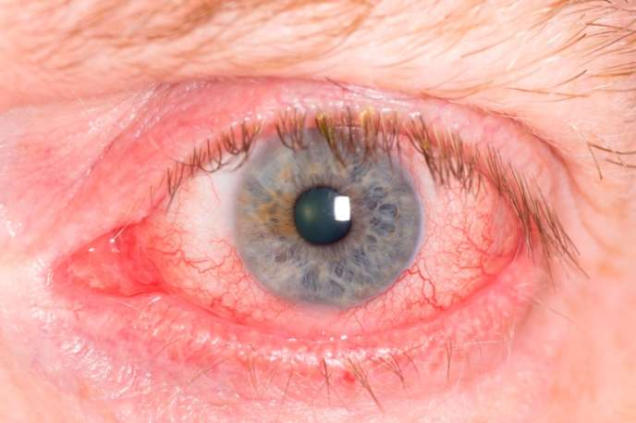
Case #3
A 6-month-old male presents with a 3 hour history of a red and tearful right eye. There is no apparent respiratory infection and no history of ocular trauma. Examination reveals an afebrile male infant who is photophobic, resists eye opening, and is crying inconsolably. Inspection of the right eye demonstrates marked conjunctivitis and tearing. Ophthalmoscopy reveals that the right cornea is cloudy and that the pupil is 4 mm and poorly reactive to light.
Discussion Questions:
What is the diagnosis?
What clinical manifestations point you toward this diagnosis?
What is the next best step in management?

Slide 12
Case #3
1. What is the diagnosis?
Acute infantile glaucoma
2. What clinical manifestations point you toward this diagnosis?
Corneal clouding
Conjunctivitis
Tearing
3. What is the next best step in management?
Emergent referral/consult to Pediatric Ophthalmology
Notes:
Infantile glaucoma: a form of developmental glaucoma that presents in the first year of life
- glaucoma may lead to blindness, so prompt recognition and treatment is essential

Slide 13
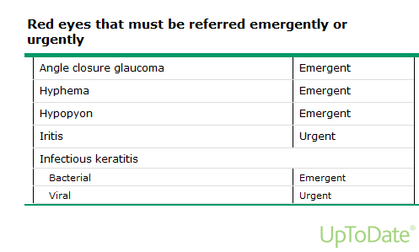
When to Refer to Ophthalmology…

Slide 14
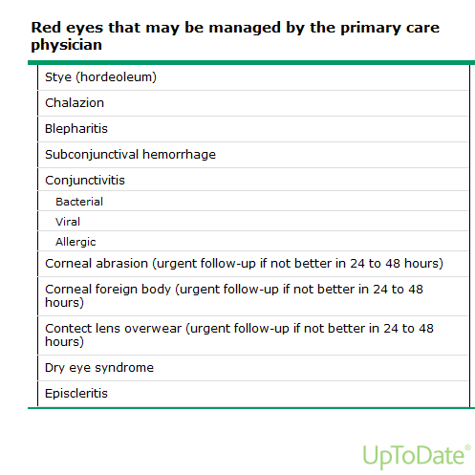
Red eyes managed by the PCP…

Slide 15
PREP Question
A 12-year-old girl comes to your clinic for evaluation of bilateral pink eyes, low grade fever, and ear pain for 2 days. She reports that she had a lot of crusting in the eyelashes when she awoke this morning. On physical examination, she has minimal clear to mucoid eye drainage and conjunctival injection, but no photophobia or visual changes. The patient has diffuse pharyngeal erythema, but no exudate or tonsillar enlargement. Her tympanic membranes are gray with normal landmarks. You notice some tenderness to movement of the tragus and find pea-sized tender nodules in the preauricular area bilaterally. The patient is very concerned about these bumps that she had not previously noticed.
Of the following, the BEST recommendation at this time is to
A. Obtain a complete blood cell count
B. Obtain Epstein–Barr virus titers
C. Prescribe amoxicillin orally
D. Reassure and treat symptomatically
E. Refer to surgery for biopsy

Slide 16
PREP Question
A. Obtain a complete blood cell count
B. Obtain Epstein–Barr virus titers
C. Prescribe amoxicillin orally
D. Reassure and treat symptomatically
E. Refer to surgery for biopsy
PREP Pearls
benign reactive preauricular lymphadenopathy can occur with viral conjunctivitis, and cause secondary otalgia
common cause is adenovirus, which often presents with conjunctivitis, fever, pharyngitis, headache, upper respiratory symptoms, and sometimes, gastrointestinal complaints

Slide 17
References and Future Reading
Peds in Review – Conjunctivitis
UpToDate – Conjunctivitis and Red Eye
Pediatric Emergency Care Review Article – Diagnosis and management of Pediatric Conjunctivitis

