Slide 1
STRIDOR/CROUP April 27-May 8, 2015
Pediatric Continuity Clinic Curriculum
Created by: Brian Stover, PGY2

Slide 2
Objectives
Describe the presentation of croup
Discuss the different severities
Review treatments
Understand that other things cause stridor

Slide 3
Case #1
A 2 year old boy is brought to your office for a bad cough and “wheezing.” Mom reports that he had several days of a runny nose, low grade fevers, and congestion. Last night, she says he started having a “barking” cough, and had “wheezing when he breathed in.” His wheezing sound and breathing seemed to improve when she brought him outside.
What does this child likely have based on this description?
What virus usually causes this?
What factors are associated with increased severity?

Slide 4
Laryngotracheitis (Croup)
Children 6 months to 36 months
Subglottic narrowing/swelling of trachea
Stridor worsened by agitation, barking/seal-like cough, +/- increased WOB
Most commonly caused by Parainfluenza, but less commonly: RSV, adenovirus, measles, influenza

Slide 5
Factors Associated with Severity
Sudden onset of symptoms
Rapidly progressing symptoms
Previous history of croup
Underlying airway abnormality
Neuromuscular disorders or other conditions that predispose to respiratory failure

Slide 6
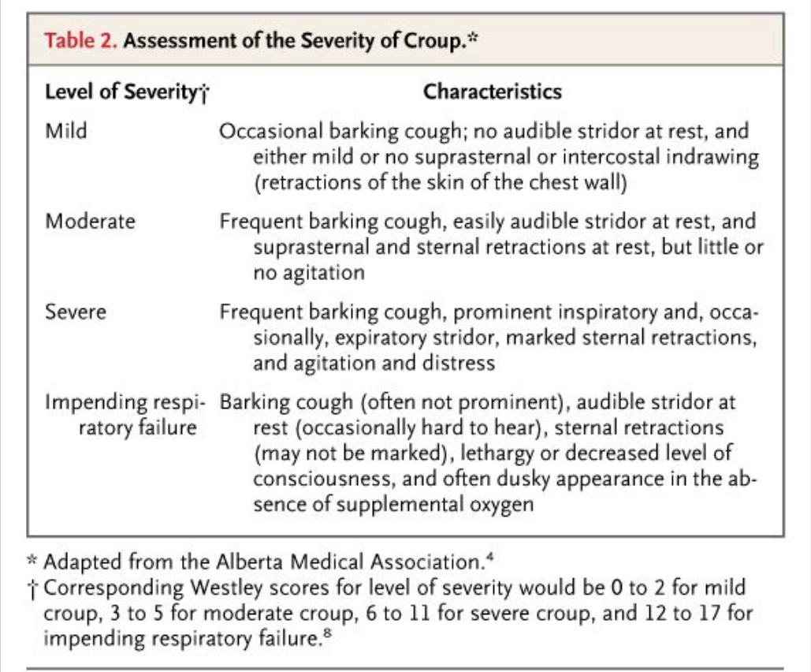
Westley Croup Score
Level of consciousness: Normal, 0; Disoriented, +5
Cyanosis: None, 0; with agitation, +4; at rest, +5
Stridor: None, 0; with agitation, +1; at rest, +2
Air entry: Normal, 0; decreased, +1; at rest, +2
Retractions: None, 0; mild, +1; moderate, +2; severe, +3
Mild: ≤2; Moderate: 3-7; Severe: ≥8
Notes:
Westley score: Level of consciousness: Normal, 0; Disoriented, +5
Cyanosis: None, 0; with agitation, +4; at rest, +5
Stridor: None, 0; with agitation, +1; at rest, +2
Air entry: Normal, 0; decreased, +1; at rest, +2
Retractions: None, 0; mild, +1; moderate, +2; severe, +3
Mild: ≤2; Moderate: 3-7; Severe: ≥8

Slide 7
Case #2
When you begin to examine the child from the previous case, you notice that he is having loud stridor and moderate retractions. The stridor does not go away at rest, and the child looks uncomfortable. Pulse ox shows saturations of 90%.
What treatment can be done immediately for this child?
Does treatment differ depending on severity?

Slide 8
Mild Croup Treatment
Home treatment:
Shower steam
Cool night air
Humidifiers
Warm fluids
Outpatient treatment:
Oral dexamethasone 0.6mg/kg (max 10mg) – single dose
Notes:
Can give IV preparation as PO (just note its 4mg/mL concentration, NOT 1mg/mL)

Slide 9
Moderate to Severe Treatment
In addition to previous treatments:
Pulse ox
Humidified oxygen if hypoxic
Racemic epinephrine – nebulizer over 15 minutes, repeat as necessary
Budesonide neb (2mg) can be used if no dexamethasone

Slide 10
Discharge/Home Criteria
No stridor at rest
Normal pulse ox
Good air movement
Normal color and level of consciousness
Tolerating PO

Slide 11
Case #3
A mom brings in her 6 month old girl for a well child check. She notes that her baby girl has always had a “wheezing” sound when breathing in, that seems to get louder every time she has a cold. She says the sound improves when she is laying on her stomach, and worse on her back. However, she says she always seems comfortable while breathing, and has always fed well.
Other than croup, what is in your differential for stridor in a child?
What tests could you perform on this child?

Slide 12
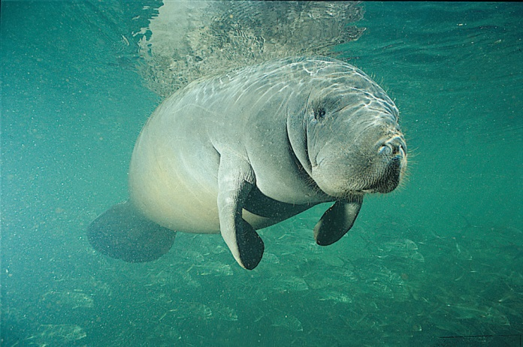
Differential of Stridor in Children
Acute Epiglottitis – less common with Hib vaccines. Rapid, high fevers, toxic appearing. Sitting up and drooling. Rarely cough.
Peritonsillar/retropharyngeal abscess – Drooling and neck extension. Cough usually absent.
Foreign Body – History of sudden choking followed by upper airway symptoms. Can be hoarse with barking cough/stridor.
Notes:
NOTE: Not a seal. That is a manatee. I think.

Slide 13
Differential of Stridor in Children
Allergic reaction – rapid onset. No preceding fevers/URI symptoms. +/- lip/tongue swelling, urticaria, dysphagia
Upper airway injury – History of smoke/thermal/chemical burns; no fevers or viral prodrome
Upper airway anomalies – Chronic course: laryngomalacia, laryngeal webs, vocal cord paralysis, subglottic stenosis
Guillan-Barre – laryngeal nerve involvement
Bronchogenic cyst – compressing airway
Notes:
Also not seals.

Slide 14
Possible Tests
CBC or RVP – not usually performed in croup, can help identify infectious process
Radiography – Neck films can show abscess (retropharyngeal space w/air-fluid levels) vs croup (steeple sign) vs epiglottitis (thumb sign); not usually performed if croup suspected
Laryngoscopy or nasopharyngoscopy to identify airway abnormalities and severity

Slide 15
Steeple Sign

Slide 16
PREP Question 238 (2013)
You are working in the emergency department when a mother brings in her 9-month-old daughter for difficulty breathing that began several hours ago. She describes nasal congestion and mild subjective fever over the last 2 days but says that she noticed “noisy breathing” this morning. The girl’s oral intake has been adequate. Findings on physical examination reveal a respiratory rate of 40 breaths/min, a heart rate of 120 beats/min, and a temperature of 38.3°C. She is alert and interactive. Nasal congestion and audible inspiratory stridor are noted, and the stridor worsens with crying. Her lung sounds are clear except for transmitted upper airway noise. Her mucous membranes are moist but she is not drooling. The remainder of the physical examination findings are normal.
Of the following, the therapy that is MOST likely to provide benefit at this time is:

Slide 17
A. inhaled albuterol
B. inhaled helium-oxygen
C. inhaled racemic epinephrine
D. intravenous ceftriaxone
E. intravenous fluids

Slide 18
A. inhaled albuterol
B. inhaled helium-oxygen
C. inhaled racemic epinephrine
D. intravenous ceftriaxone
E. intravenous fluids

Slide 19
PREP Question 212 (2015)
A 1-year-old infant is brought to your office for evaluation. The parents state that the infant was “born with asthma.” He has been noted to have wheezing for the past year, wheezing once to multiple times a day. The wheezing is occasionally related to exertion and to a full feed. He has been prescribed 2 puffs of a short-acting β-agonist with a spacer for these episodes, but the parents do not use it consistently, as it seems to help him only when he has an underlying cold. He was noted to spit up when he was younger, but this has improved since he began ambulating. He has never had to seek urgent treatment for his wheezing and has never received treatment with steroids. His height and weight are at the 50th percentile. His physical examination is unremarkable and his lungs are clear on examination.
Of the following, the MOST appropriate test to order is:

Slide 20
A. allergy testing
B. barium swallow
C. echocardiogram
D. pH probe
E. sweat chloride

Slide 21
A. allergy testing
B. barium swallow
C. echocardiogram
D. pH probe
E. sweat chloride
Notes:
The appropriate test to order for the infant in this vignette is a barium swallow in order to evaluate for the possibility of gastroesophageal reflux and congenital abnormalities of the tracheobronchial tree and thoracic structures as the cause of the wheezing. Infantile wheezing that does not respond to inhaled bronchodilators and occurs daily, rather than intermittently, points to etiologies other than asthma. Barium swallow may also help in identifying swallowing dysfunction, aspiration syndromes, and some cases of tracheoesophageal fistula. The history of his symptoms being related to feeding, on occasion, and improving with ambulation suggests resolving gastroesophageal reflux.

Slide 22
References
Cherry JD. “Croup.” N Engl J Med 2008; 358:384-391
Gilbert EG, Russell KE, Deskin RW. “Stridor in the infant and child. Assessment, Treatment.” AORN J 1993; Jul;58(1):23, 26-31
Boudewyns A et al. “Clinical Practice: An approach to stridor in infants and children.” Eur J Pediatr. 2010;169(2):135

